Slide 1

Digital Marketing Strategy

Slide 2
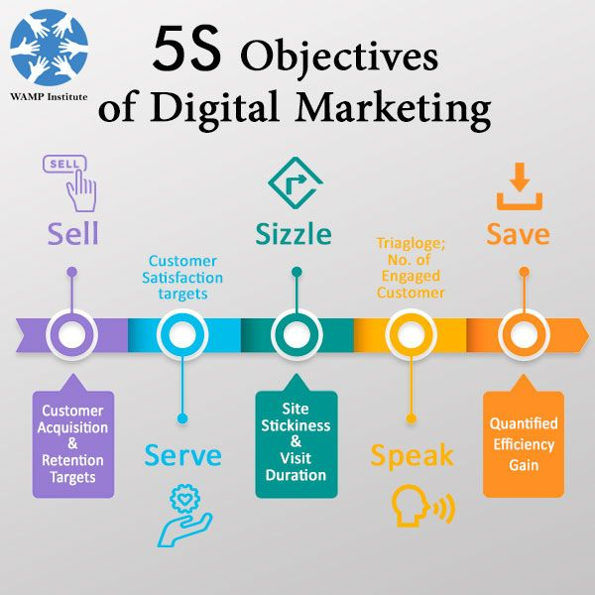
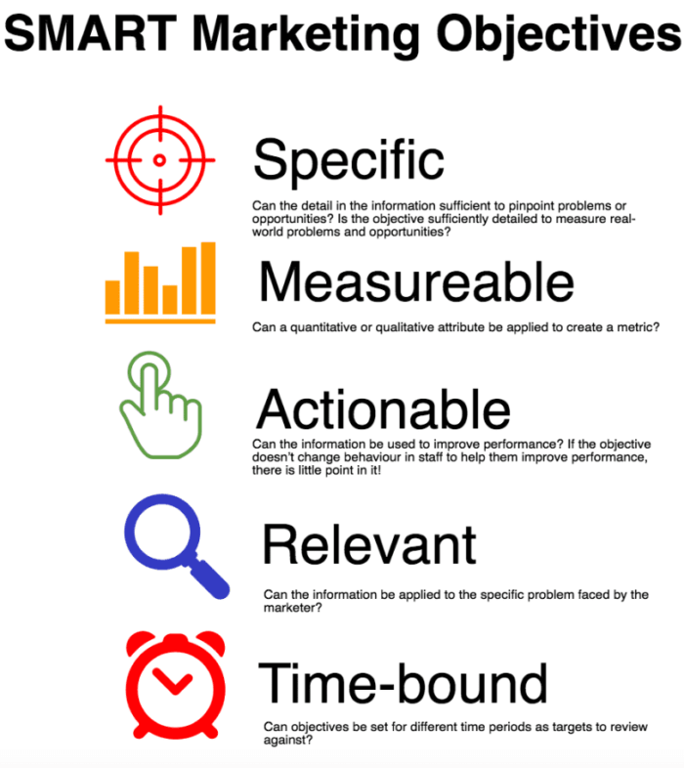
Digital marketing strategy
Objectives

Slide 3
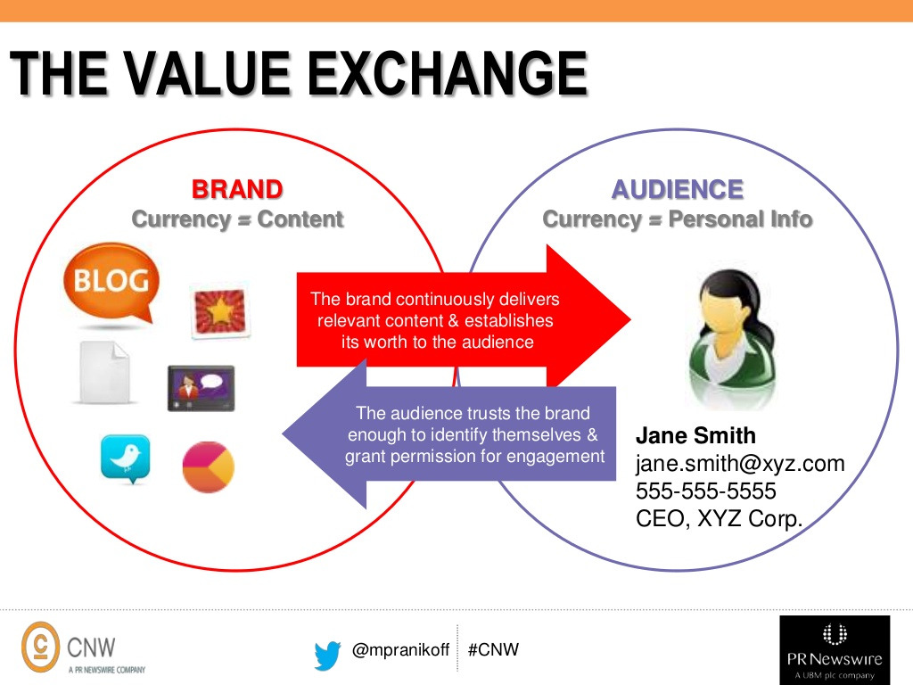
Digital marketing strategy
Value-Exchange
What value are you adding to the market, what are you trying to achieve and how will you know if you are successful?
Once you have defined what constitutes success and have delineated your prime objective, you can examine other goals that support this objective

Slide 4
Digital marketing strategy
Tactics and Evaluation
A diverse variety of digital tools and tactics are available once you have defined your digital marketing objectives.
The strength of the tools is dependent on the type of objectives set for the brand
Tools
Search Engine Optimization (SEO)
Pay-Per-Click (PPC) Marketing
Webinar Production
Content Marketing (Blogging & Article Writing)
Downloadable Content Offerings (eBooks, Whitepapers, Webinars)
Email Marketing
Social Media Marketing
Video Production
Website Design A/B Testing
Landing Page Strategy
Call-To-Action Strategy
Link Building/Earning
Infographic Design
Marketing Automation
Lead Nurture Strategy
Public Relations (PR)

Slide 5
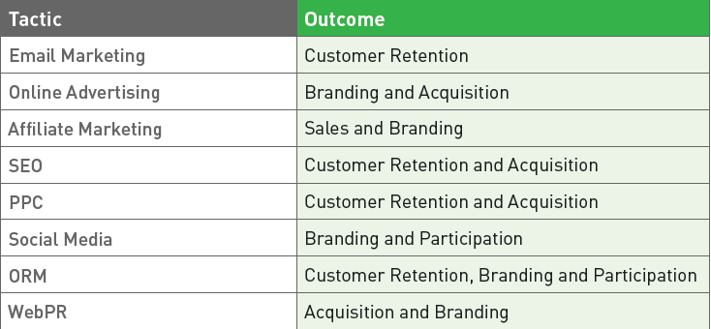
Digital marketing strategy
Tactics and Evaluation

Slide 6
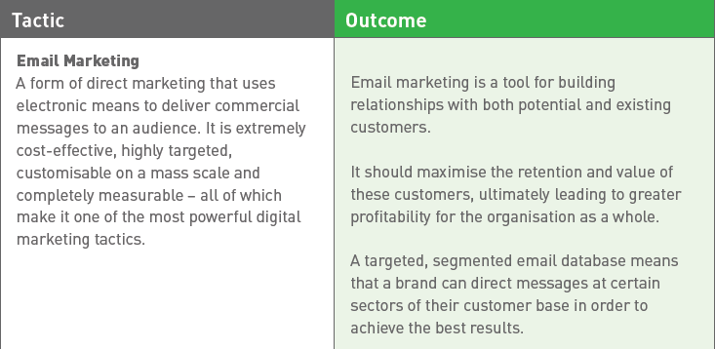
Digital marketing strategy
Tactics and Evaluation

Slide 7
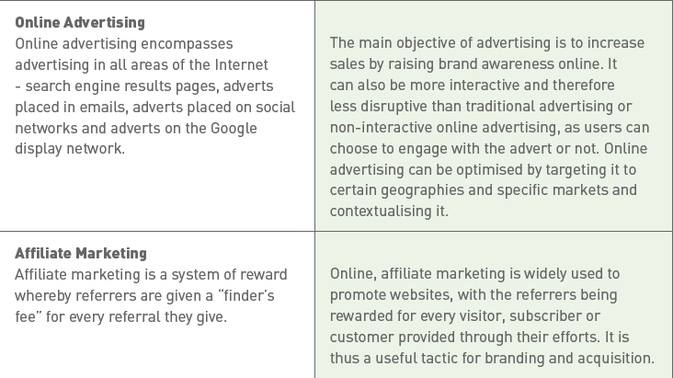
Digital marketing strategy
Tactics and Evaluation

Slide 8
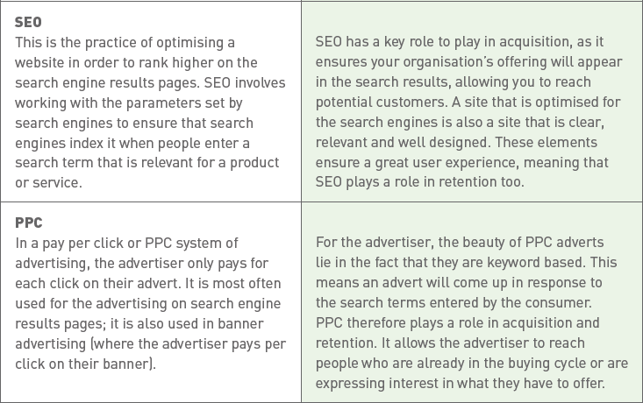
Digital marketing strategy
Tactics and Evaluation

Slide 9
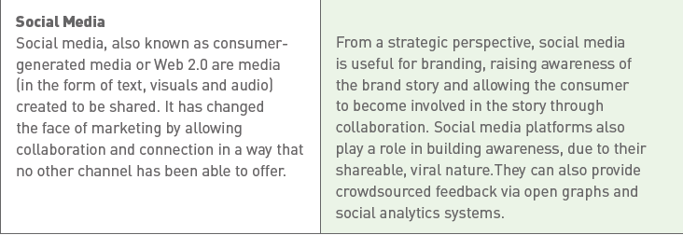
Digital marketing strategy
Tactics and Evaluation

